Slide 1
Distributed vision-based flying cameras to film a moving target
Fabio Poiesi, Andrea Cavallaro
Centre for Intelligent Sensing
Queen Mary University of London

Slide 2
Objective
Develop a distributed algorithm to coordinate a formation of flying “smart” cameras to follow a moving target
Why is the problem important?
single camera visual following
may lose the target
local decisions could be inaccurate
due to noisy measurements
Notes:
remember to apply colours to quadrotors

Slide 3
Challenges
Noisy target detections
may generate incorrect control commands
Quadrotor oscillations
target may go outside camera fields of view
Maintain initial formation geometry
geometric deformations need formation recalibration
Adapt to target motion variations
may lead to target loss
Notes:
here you should provide the idea that you need to compensate detection errors, but you need to understand when the target is actually moving

Slide 4
Proposed approach overview
velocities
predictions
vision-based inference
(position mapping)
distributed consensus
formation maintenance
quadrotor dynamics
video analytics
delay

Slide 5
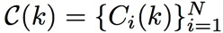
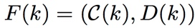
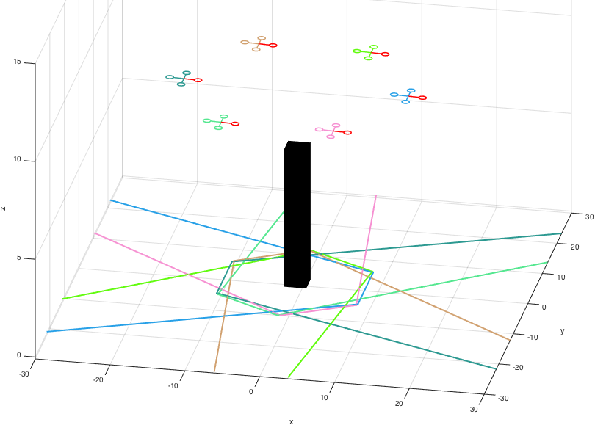
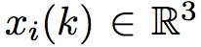
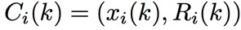
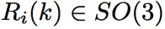
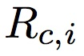
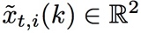
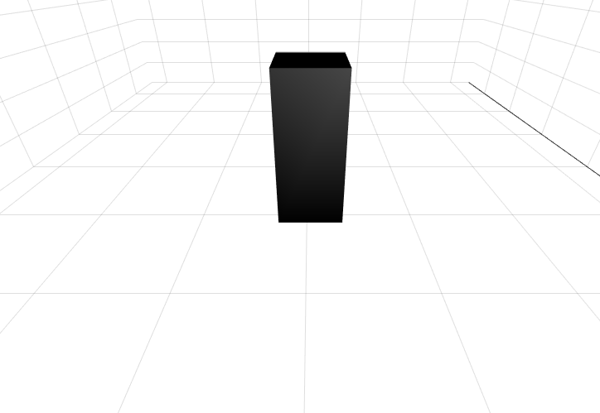

Definitions
velocities
predictions
video analytics
vision-based inference
(position mapping)
distributed consensus
formation maintenance
quadrotor dynamics
delay
formation
connectivity (distances) of
position
attitude (orientation)
On-board camera
fixed orientation
detected target
Examples of flying camera views

Slide 6
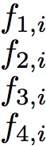
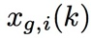
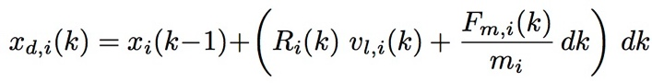
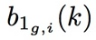
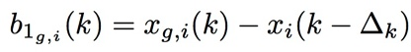
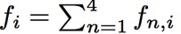
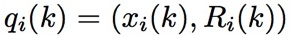
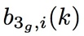
Flying camera controller [Lee2010]
velocities
predictions
video analytics
vision-based inference
(position mapping)
distributed consensus
formation maintenance
quadrotor dynamics
delay
b_{2,1}(k)
b_{3,1}(k)
Input
b_{1,1}(k)
goal trajectory point
desired first body direction
Given and
*stable translational
dynamics
Compute this!
- behaviour neighbours
- camera plane target position
T. Lee et al., “Geometric tracking control of a quadrotor UAV on SO(3),” in ICRA 2010

Slide 7
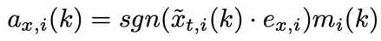
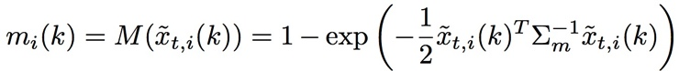
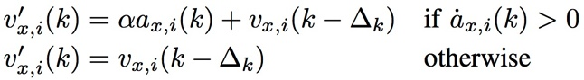
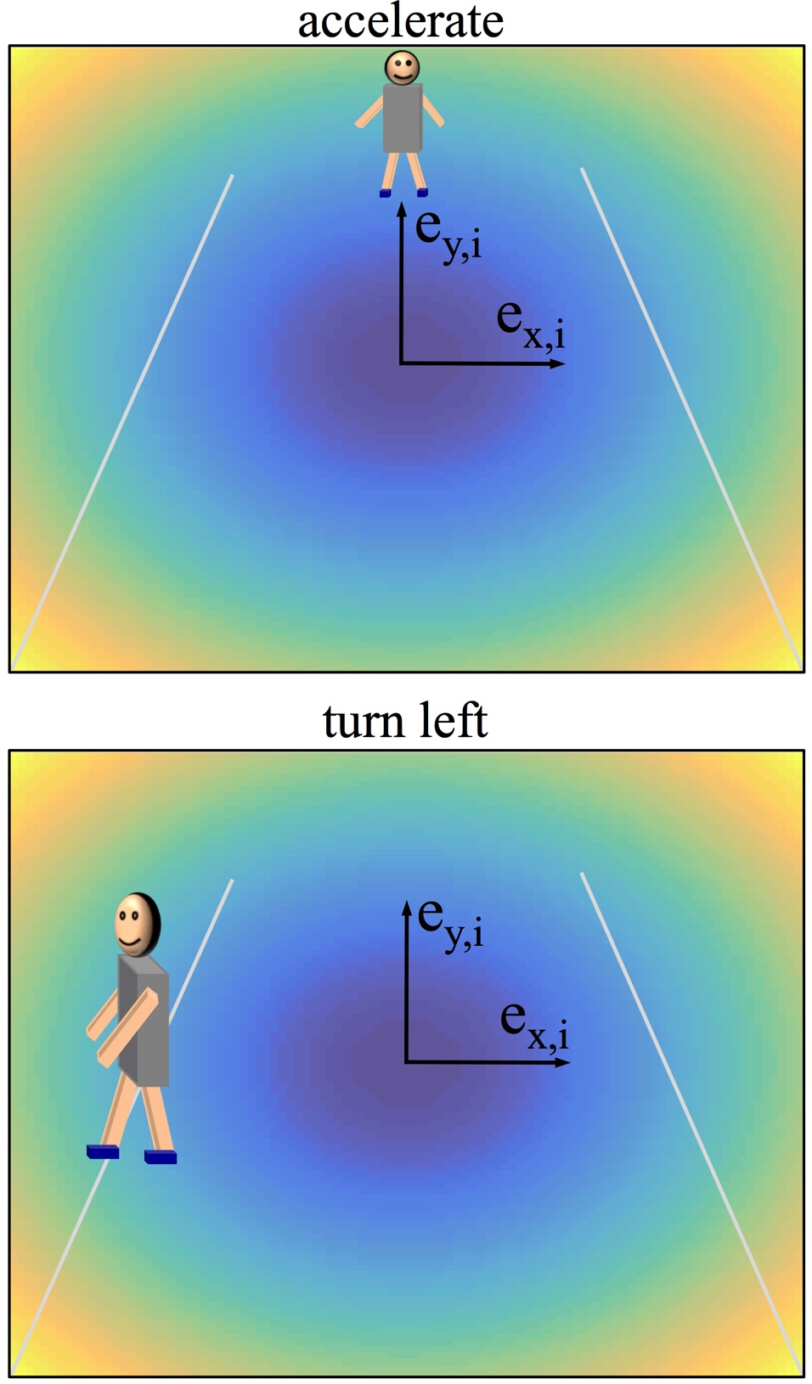
Vision-based inference
velocities
predictions
video analytics
vision-based inference
(position mapping)
distributed consensus
formation maintenance
quadrotor dynamics
delay
We want to maintain the target centred on each camera plane
Each flying camera adapts its velocity
Gain
Direction (e.g. x-axis)
regulariser
amplifier term
Illustrations (example)

Slide 8
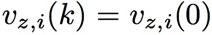
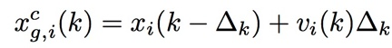
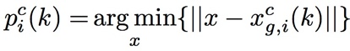
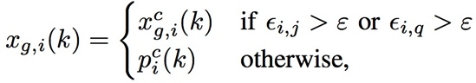
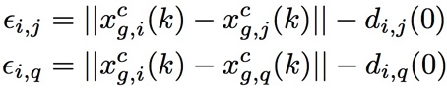
Distributed formation control
velocities
predictions
video analytics
vision-based inference
(position mapping)
distributed consensus
formation maintenance
quadrotor dynamics
delay
velocity agreement
Velocity visually inferred could be noisy
Formation maintenance
[Anderson2008]
neighbours
d_{i,j}
No sufficient
to maintain formation!
~d_{i,j}
circle intersection points
~d_{i,q}
d_{i,q}
B.D.O. Anderson et al., “UAV formation control: Theory and application,” in Recent Advances in Learning and Control, 2008
Notes:
Compared to a leader-follower formation a non-hierarchical formation control is more robust against (detection) noise and to speed variations of individual cameras within the formation

Slide 9
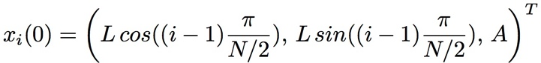
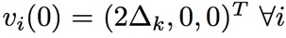
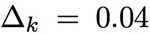
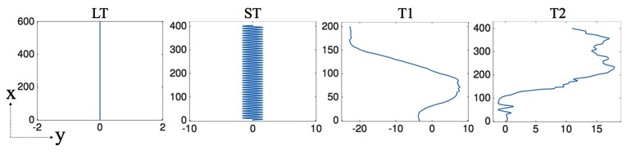
Simulation results
Evaluate ratio of cameras viewing a moving target
Number of flying cameras N = 6, 8, 10, 12
Flying cameras initialised on target
number of cameras viewing the target
total number of cameras in the formation
15
10
target trajectories
8s
80s
8s
186s

Slide 10
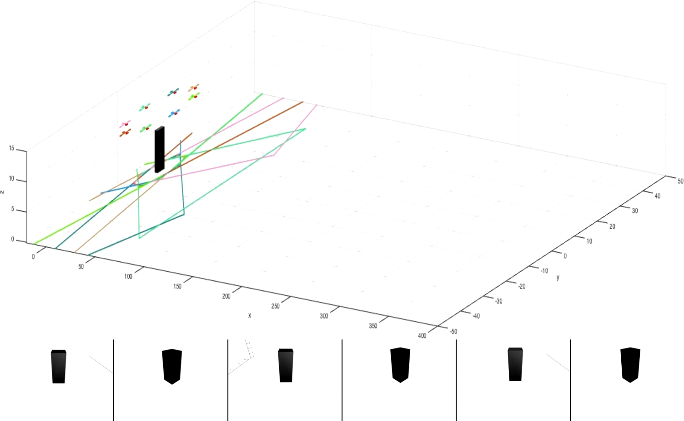
Flying camera formation

Slide 11
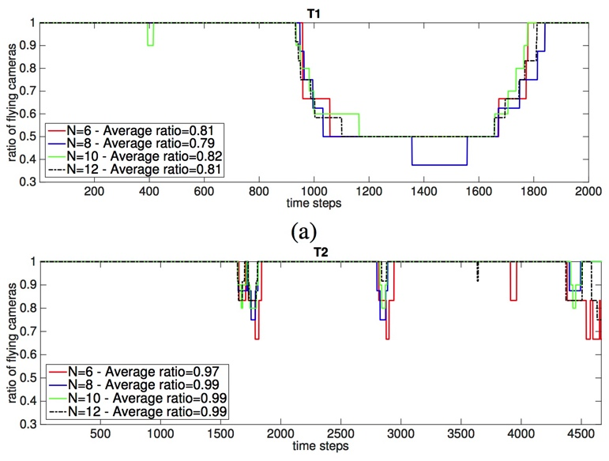
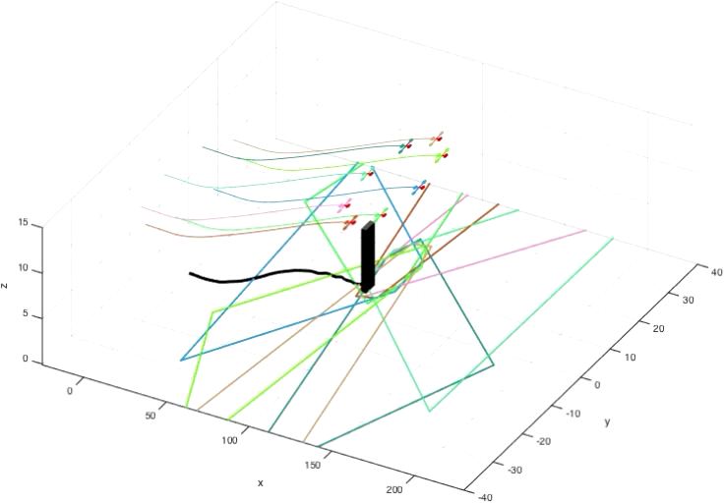
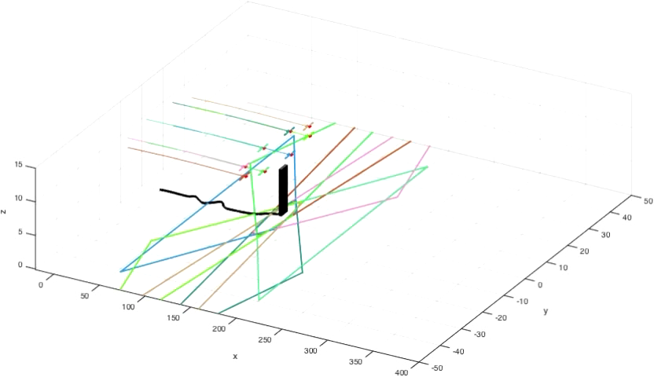
Robustness to target motion variations
LT and ST perfect results!
GPS-based only approach fails [Poiesi2015]
T1 and T2
F. Poiesi and A. Cavallaro, “Self-positioning of a team of flying smart cameras,” in ISSNIP 2015

Slide 12
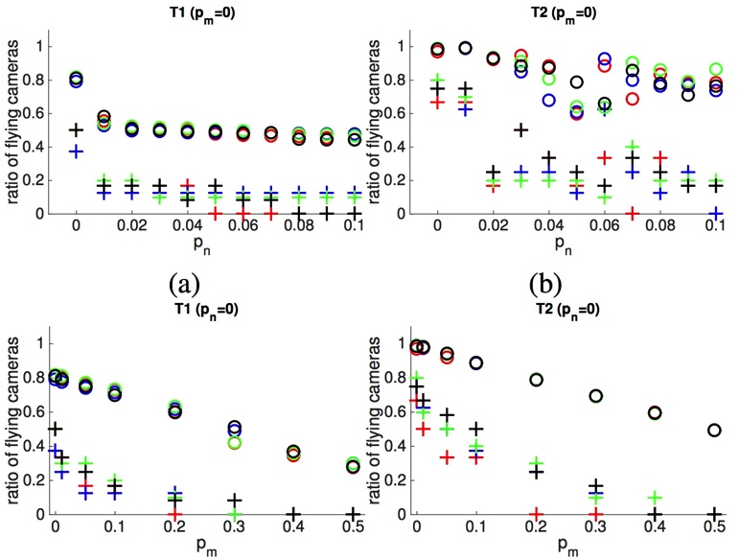
Noisy target detections
Model → inaccurate target position and miss-detections
T1 (miss-detections=0)
T1 (position noise=0)
position noise
miss-detections

Slide 13
Conclusions
Distributed algorithm helps maintaining formation in presence of noisy detections
Formation of flying cameras enables target following via visual feedback (no GPS location)
Few cameras viewing the target allow the whole formation to avoid target loss
Future work
Multi-altitude formation
PID controller to improve stability

